Slide 1

FACIAL EMOTION DETECTION

Slide 2
Problem Statement
Data Sourcing
EDA
ETL
Architecture
CNN Model & Model Architecture
Model Training & Evaluation
Real-Time Emotion Detection
Emotion Prediction from Video & Live Demo
Summary & Future Scope
References
CONTENTS

Slide 3
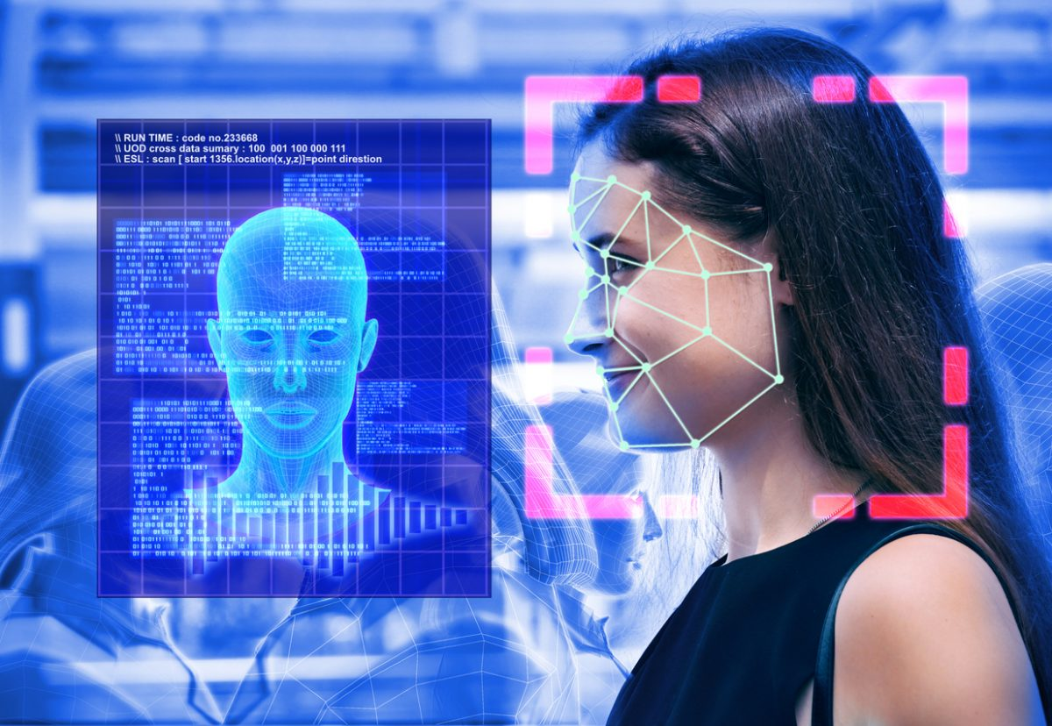
PROBLEM STATEMENT
Real-time understanding of human emotions in diverse digital applications.
Notes:
We are focusing on interpretting human emotions in real time and predict the emotions they are exhibitting.

Slide 4
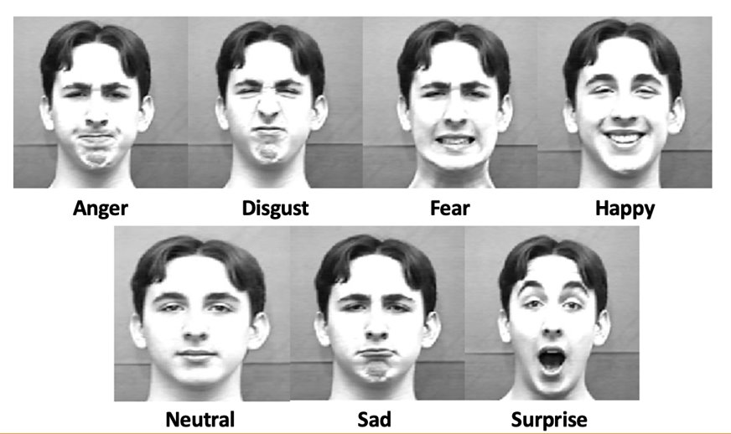
DATA SOURCING
Data Source Link: https://www.kaggle.com/datasets/aadityasinghal/facial-expression-dataset
No. of images: 35887
7 categories of expressions

Slide 5
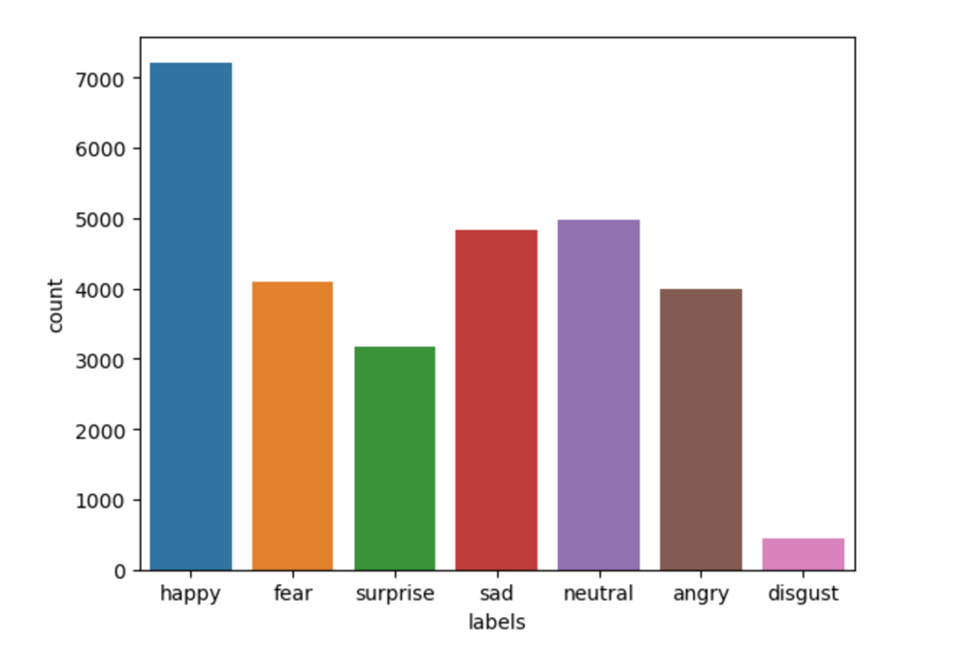
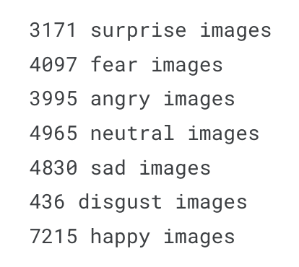
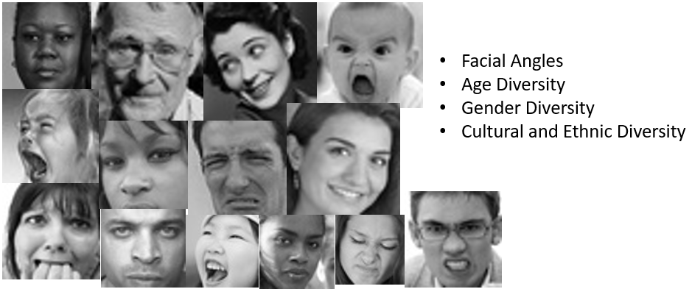
EDA

Slide 6
ETL
Transform (T):
Data Preprocessing
Image Resizing: All images resized to 48x48
Data Augmentation: Trained with additional examples created by horizontally flipping images
Splitting the Dataset: Training, Validation, and Testing subsets
Load (L):
Data Loading:
Loading libraries like TensorFlow's ImageDataGenerator, used to generate 2 ImageDataGenerator allowing batch loading and augmentation.
Batch Preparation: Batch size: 64.
Class_mode: Categorical.
Shuffle is enabled.
Notes:
We are resizing all the images to 48X48 this aids in maintaining uniformity and helps to reduce computational complexity during model training.
In Batch preparation dataset is organized into batches with a designated size of 64 images per batch this enhances computational efficiency during training the data.
DA is used to increase the no of images in dataset, this can be achieved by horizontally flipping the images.
Splitting dataset into Training, testing and validation. Validation testing helps in avoiding overfitting and helps in fine tuning model.
Load:
TensorFlow's ImageDataGenerator facilitates the loading and augmentation of images for model training.
Organizing data categorically is essential for training a facial emotion classification model. This structure allows the model to distinguish and predict various emotions distinctly.
The data is shuffled during loading, ensuring that the model encounters data in a random order during training this prevents the model from learning patterns based on the order of the data.

Slide 7
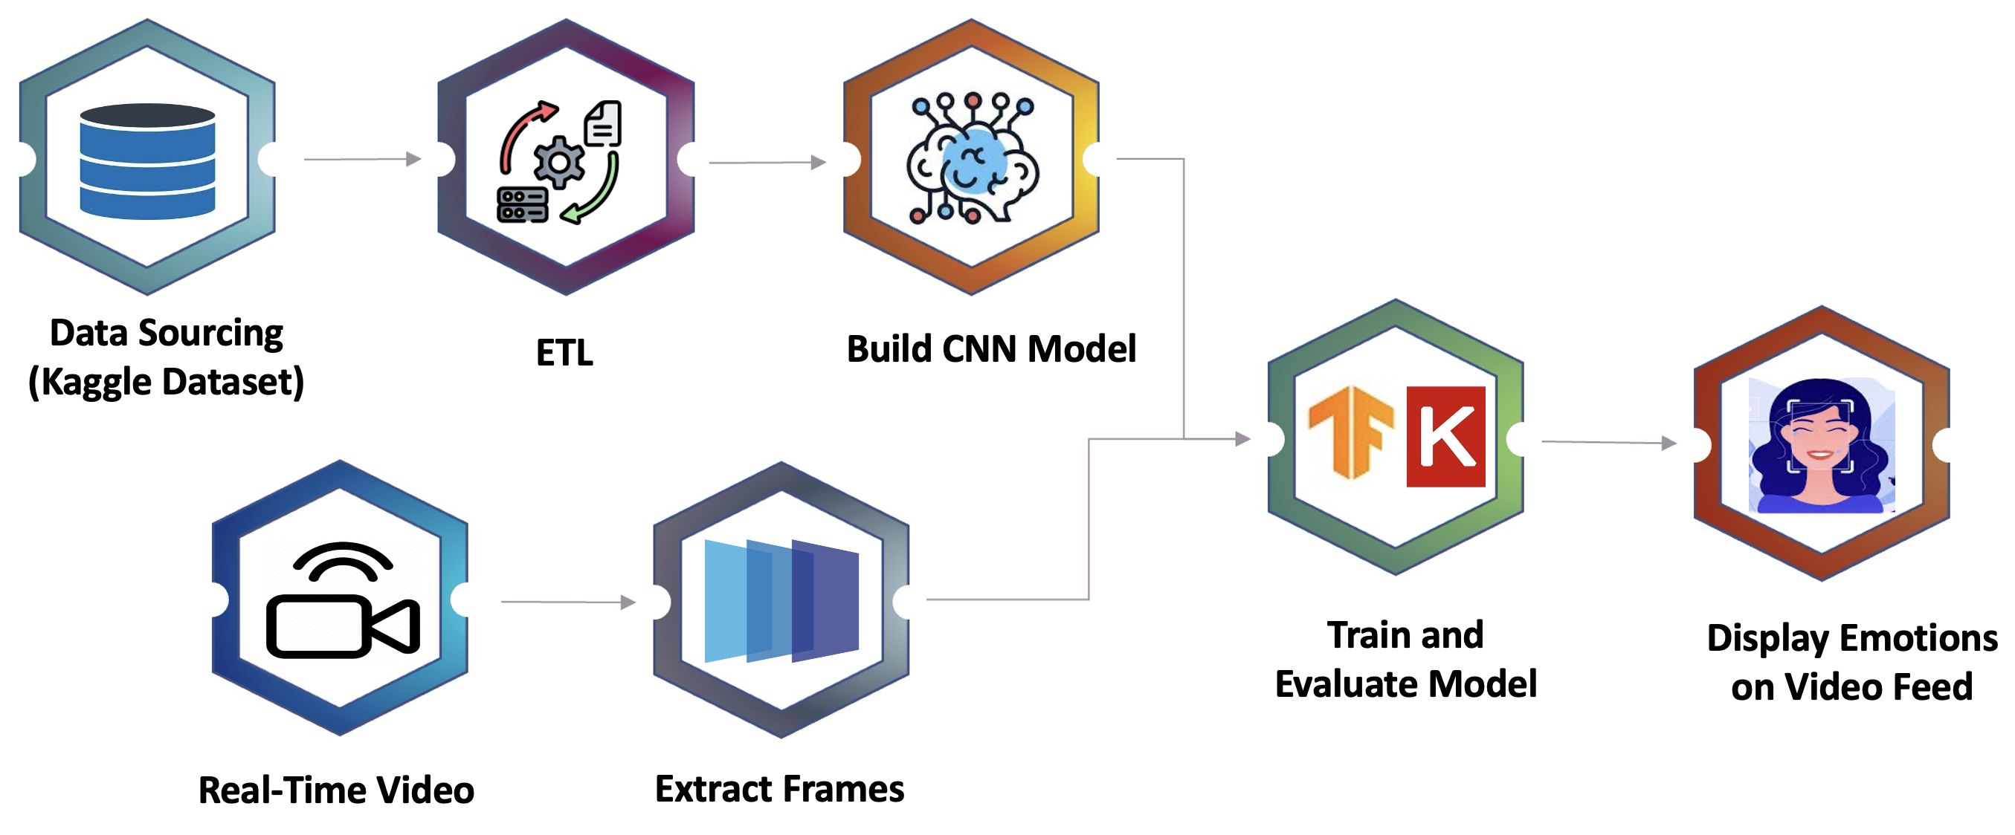
Architecture

Slide 8
Building the CNN Model
Convolution Layers:
First Convolution: 64 filters, 3x3 kernel, 'same' padding.
Second Convolution: 128 filters, 5x5 kernel, 'same' padding.
Third Convolution: 512 filters, 3x3 kernel, 'same' padding.
Fourth Convolution: 512 filters, 3x3 kernel, 'same' padding.
Batch Normalization :Applied after each Convolutional and Dense layer.
Activation: Rectified Linear Unit (ReLU) is used to introduce non-linearity.
Max Pooling Layers: Pool Size: 2x2.
Dropout Layers
Fully Connected Layers:
First Fully Connected Layer: 256 neurons.
Second Fully Connected Layer: 512 neurons.
Output Layer: 7 neurons (for 7 classes), softmax activation.
Flattening Layer

Slide 9
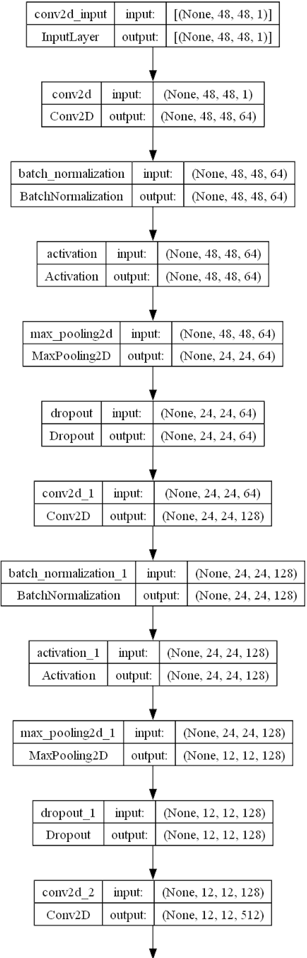
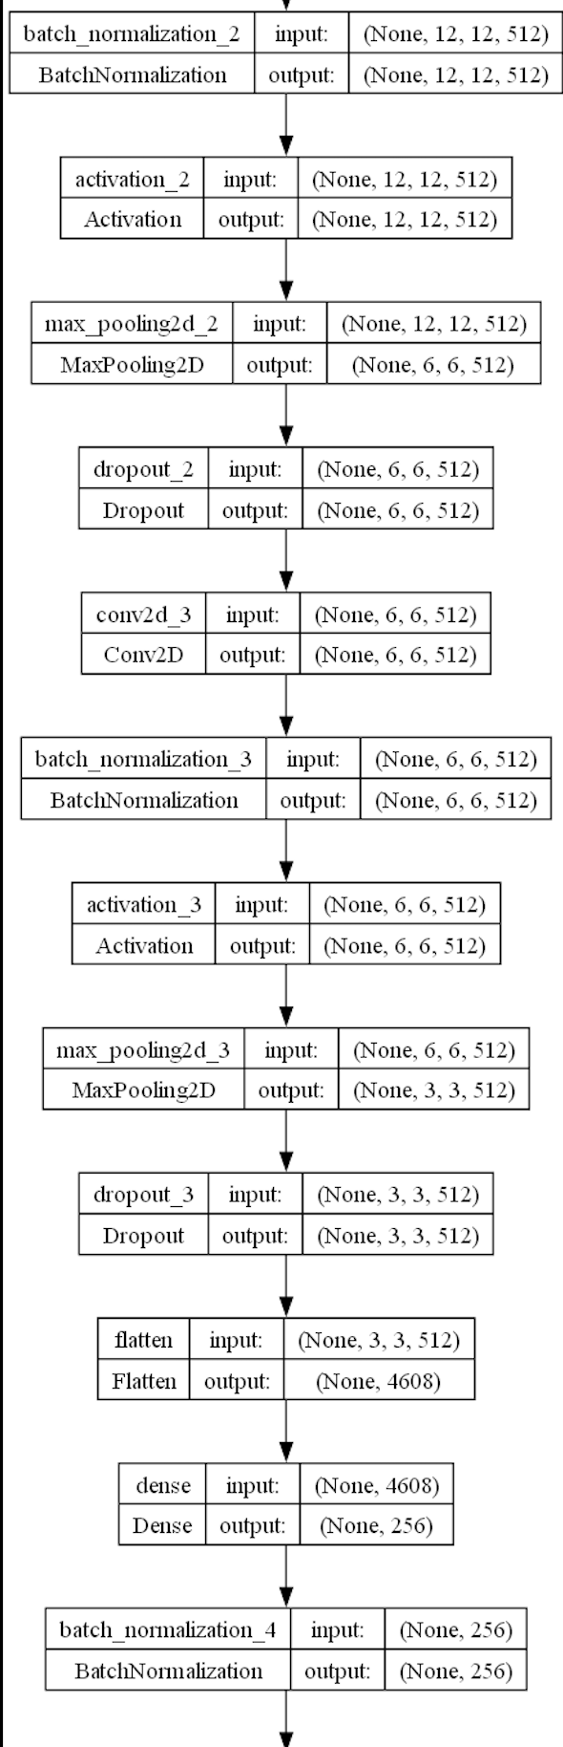
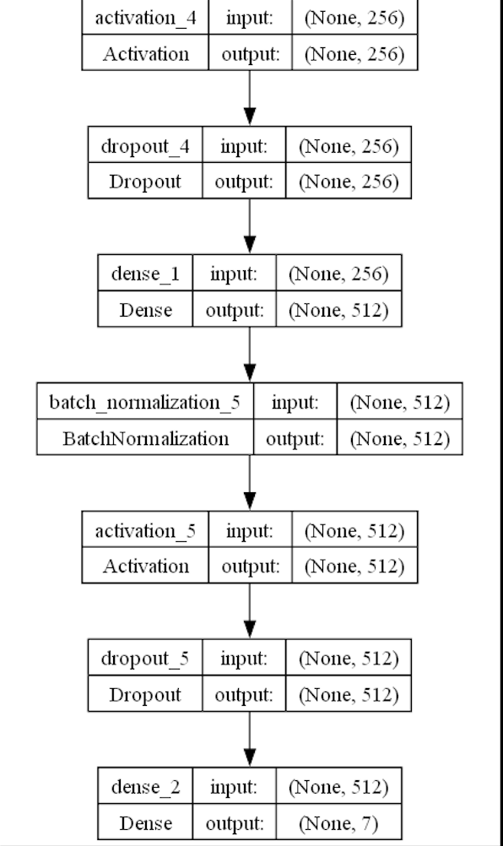
Model Architecture

Slide 10
Model Training & Evaluation
Model Compilation:
Optimizer: Adam (lr=0.0005)
Loss Function: Categorical Crossentropy
Metrics: Training Accuracy and Validation accuracy.
Training Configuration:
Epochs: 15
Steps_per_epoch: Number of batches of samples to use in one epoch.
Validation_steps: Number of batches to evaluate at the end of each epoch on the validation dataset.
Callbacks:
ReduceLROnPlateau: monitor='val_loss', factor=0.1, patience=2, min_lr=0.00001, mode='auto'
ModelCheckpoint: Saves the model weights whenever there is an improvement in validation accuracy.
Training the Model:
fit(): Initiates the training process.
train_generator: Training data generator.
validation_generator: Validation data generator.
callbacks: List of callbacks to apply during training.

Slide 11
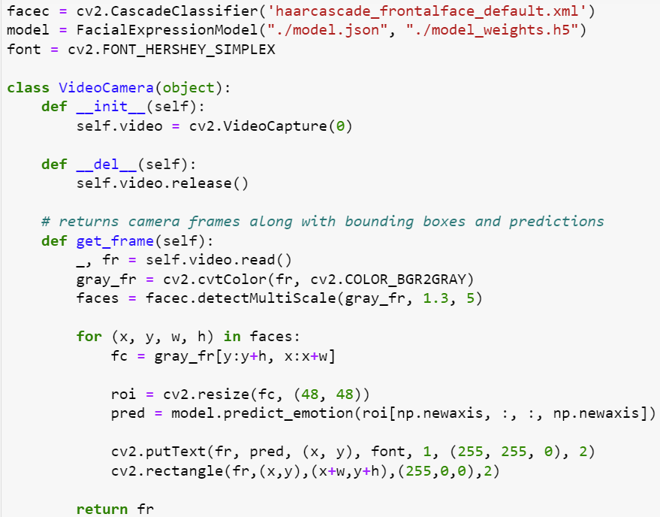
Real-Time Facial Emotion Recognition
Technology at Work:
•Python and OpenCV
Key Components:
•Haar Cascade Classifier
•Facial Expression Model
Process Flow:
•Capturing Video
•Image Processing
•Face Detection and Emotion Recognition
Practical Applications:
•"Potential uses span across interactive applications, psychological studies, and enhancing user experiences."

Slide 12
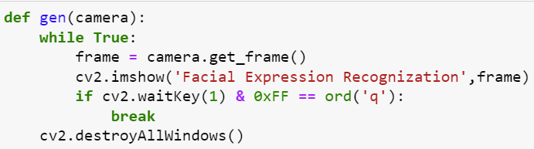
Emotion Prediction from Video
Emotion Prediction:
"Harnessing the power of computer vision and machine learning to interpret human emotions from facial expressions in real-time video."
Real-Time Interaction:
Interactive User Experience:
"Displaying the identified emotions on the video feed in real-time, offering an interactive and engaging user experience."

Slide 13

Live Demo

Slide 14
Emotional Transition
Where is the complexity?
After Live Demo

Slide 15
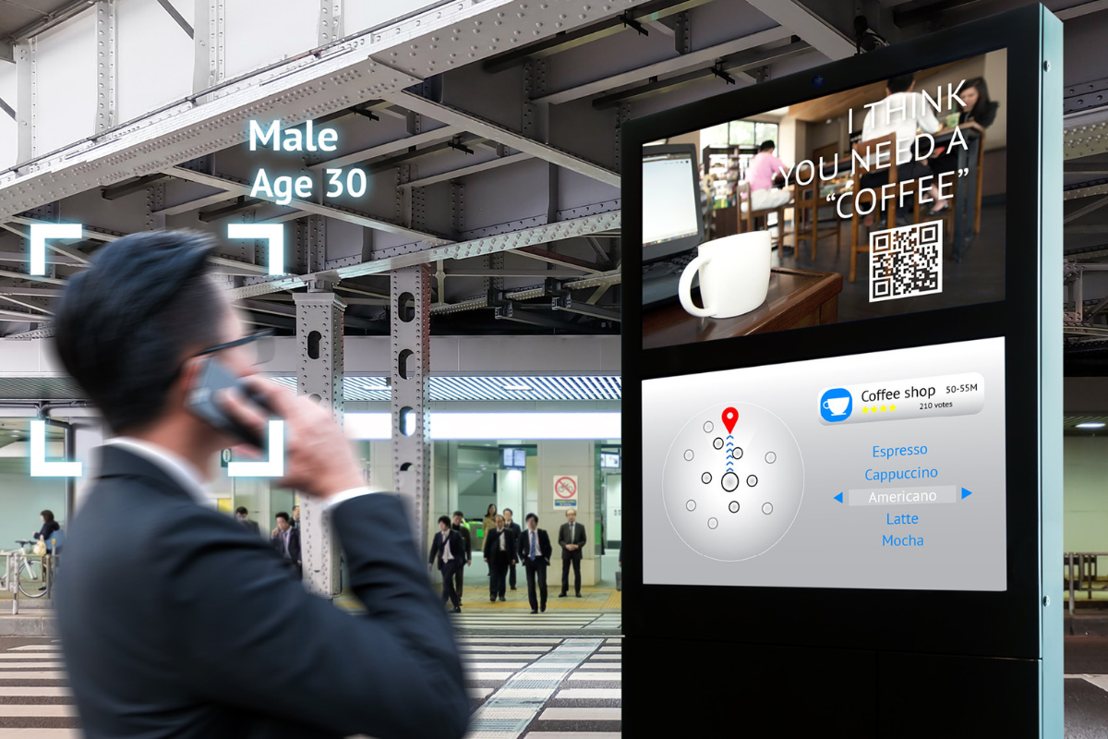
Summary
Valuable Instrument in a Retailer’s Toolkit
Personalized recommendations, Targeted marketing
Future of Digital Health
Better understanding of patient’s emotional state means better treatment
Aid people with autism to recognise emotions
Augmented Reality glasses to prompt the emotional states of people

Slide 16

Future Scope
Detect Genuine Emotions
Detect genuine emotions through multiple modalities:
Speech
Tone
Body language
Context and Timing
Recurrent Neural Networks
Capture temporal dynamics using RNN
Privacy-Preserving Techniques
Safeguard individuals’ privacy by:
On-device processing
Homomorphic Encryption
Explicit Consent

Slide 17
References
https://www.forbes.com/sites/forbestechcouncil/2022/11/23/emotion-ai-why-its-the-future-of-digital-health/?sh=5eb0d70e6516
https://www.auganix.org/mit-research-that-utilizes-ai-for-facial-emotion-recognition-points-to-potential-benefits-of-augmented-reality-for-people-with-autism/
https://www.theceomagazine.com/business/innovation-technology/emotion-artificial-intelligence/
https://chat.openai.com

Slide 18
THANK YOU

